Slide 1
Simulation Product Line Final sprint

Slide 2
Agenda
Achievements
Gained knowledge
Demo UC4
Reflection

Slide 3
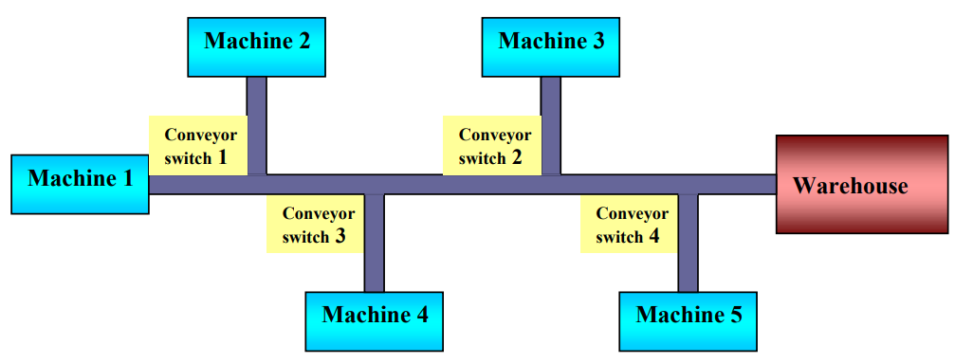
Achievements
Simulations
Automatic assembly line
Supermarket
Transport system
Operator controlled assembly line

Slide 4
Gained knowledge
Enterprise Dynamics
Basic system modeling
Stochastics (random probability distributions)
Channel manipulation
M/M/c queueing model
Human resource management
Notes:
The M/M/c queueing model is a mathematical model that describes systems where multiple servers handle the incoming tasks.

Slide 5
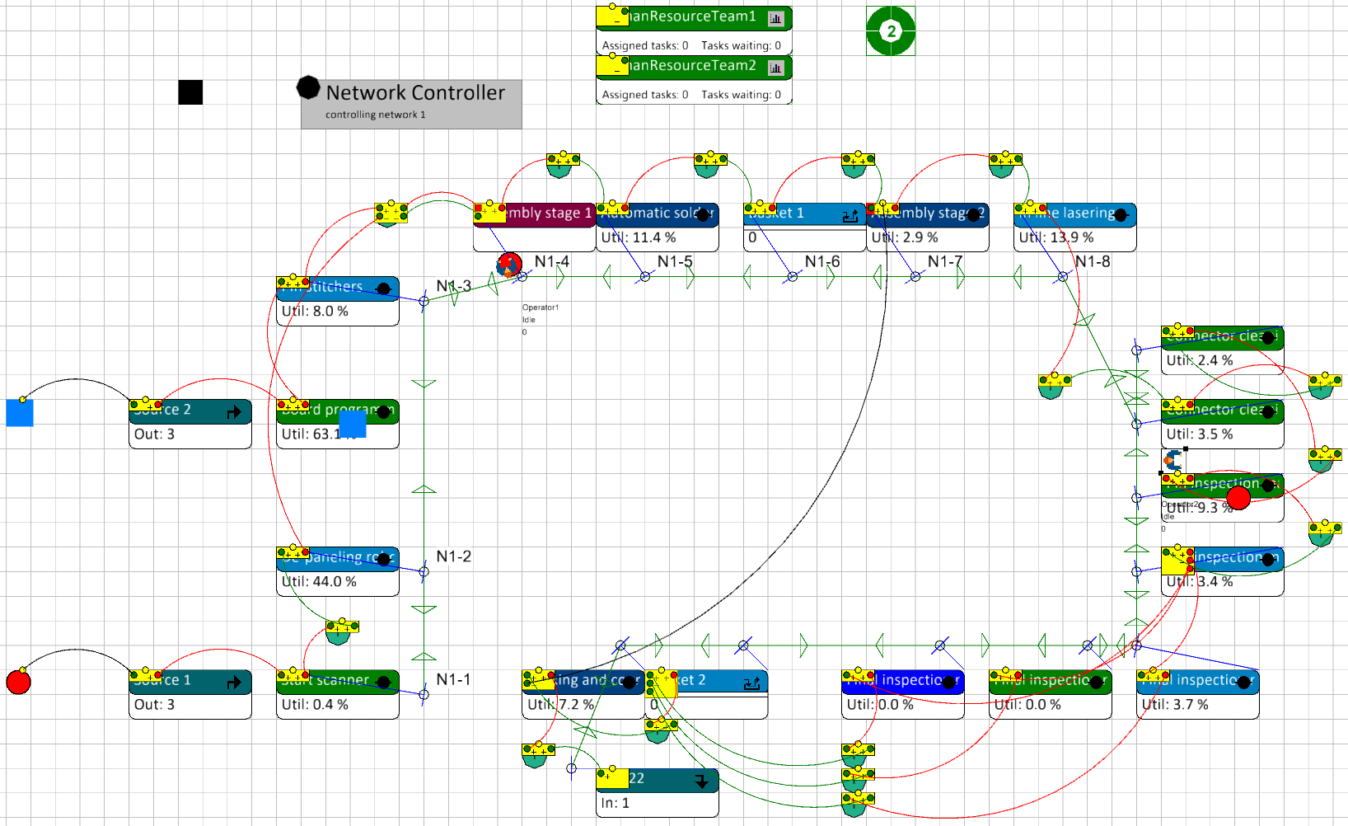
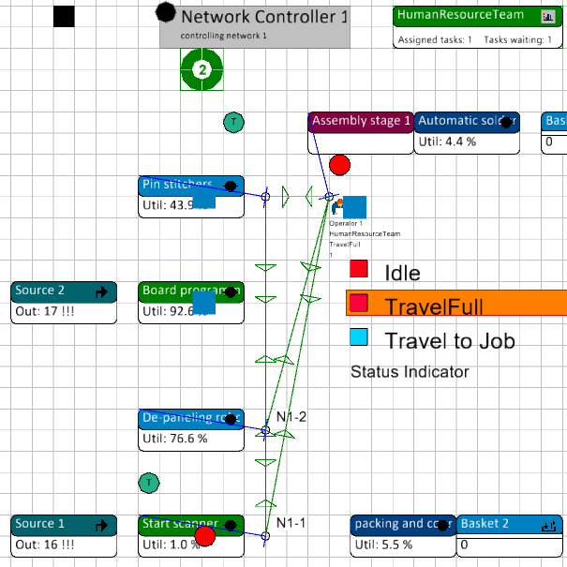
Operator controlled assembly line

Slide 6
Reflection
Project result
Problem solving
Learning outcomes
Time management
Future improvements
Notes:
I’m overall very satisfied with my results within this project. I gained allot of knowledge about simulations.
I’m more aware about the steps that I need to take to get to a solution and solve a problem.
Overall, my time management was very good. But often I still find myself getting too focused on specific solutions, which can make it difficult to consider other possibilities.
Fix the human resource transfers
This project is a good addition show my learning outcomes.

Slide 7
Thank you
Questions?

